Slide 1
OpenGL
Uniform blocks and uniform buffers
Advanced Graphics Programming

Slide 2
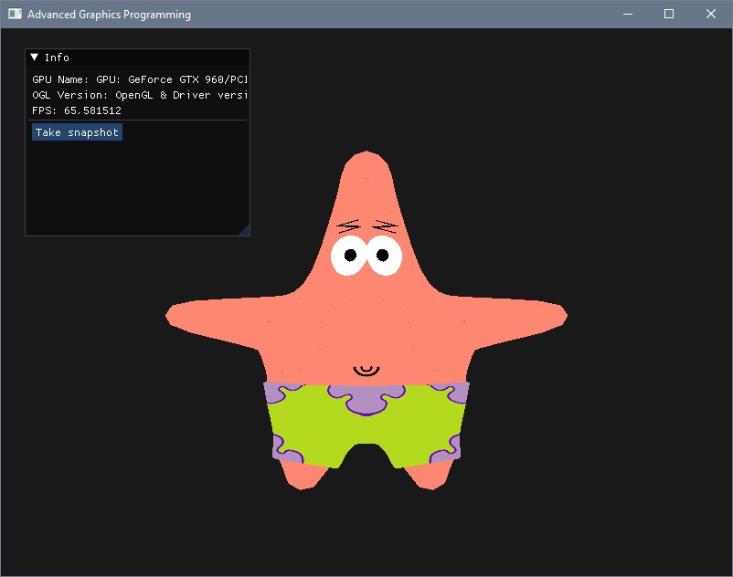
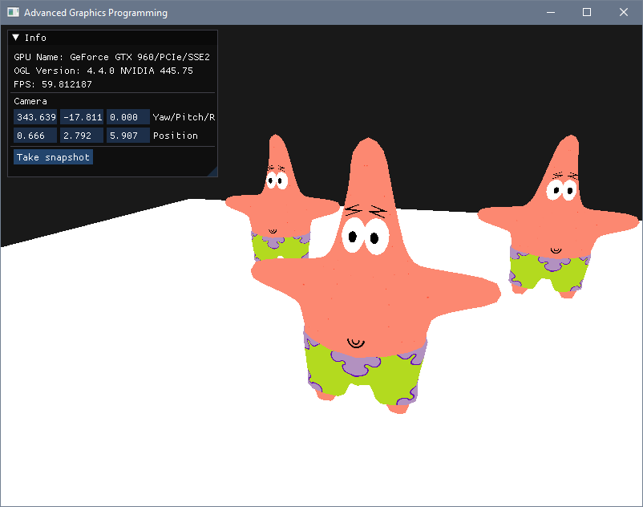
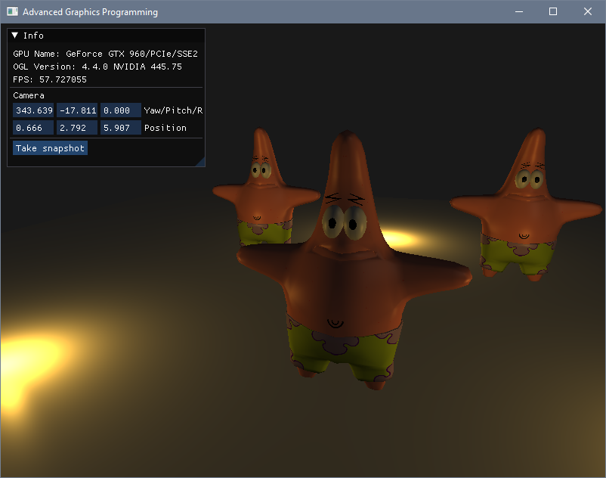
We added transforms, now lights

Slide 3

You think that alignment stuff was difficult?

Slide 4
Shader block member alignment
Speaking about alignment, if we start filling a buffer from offset 0 with values of type mat4… we are lucky, it is a type that works ‘out of the box’ (vec4 too)
mat4
mat4

Slide 5
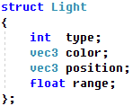
Shader block member alignment
But we cannot generalize. In shader blocks, memory alignment does not work as in a C++ program.
Int
Vec4
Vec3
float
Int
Vec4
Vec3
float
padding
padding
Alignment in main memory
Alignment in video memory

Slide 6
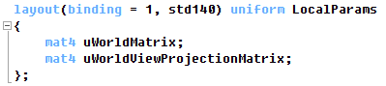
Uniform block layouts
Packed. Platform dependent. Offsets need to be queried. Equal block descriptions can have different offsets on different shaders (cannot be shared). Most performance/memory efficient.
Shared. Platform dependent. Offsets need to be queried. Equal block descriptions will have equal offsets on different shaders (can be shared). Also very performance/memory efficient.
Std140. Platform independent. Layout rules are explicit, so we know the offsets following the layout rules. Quite performance efficient. Not memory efficient.
Std430. Platform independent. Layout rules are explicit, so we know the offsets following the layout rules. Less performance efficient than std140. More memory efficient in arrays.

Slide 7
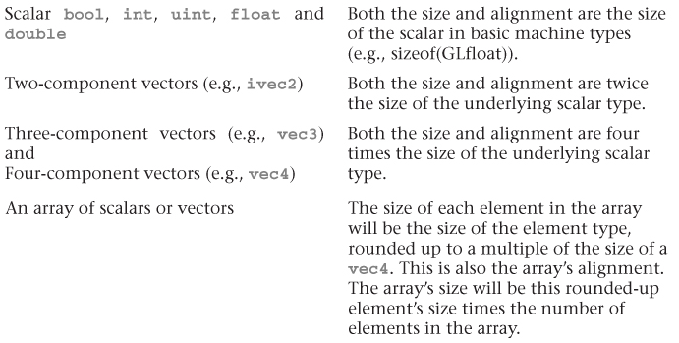
std140 uniform block layout (alignment rules)

Slide 8
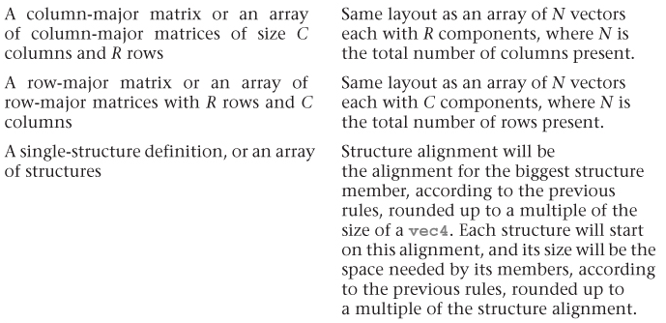
std140 uniform block layout (alignment rules)

Slide 9
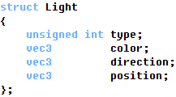
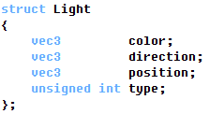
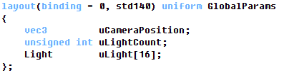
A couple of examples
How would the alignment of these structs be?

Slide 10

Adding lights

Slide 11
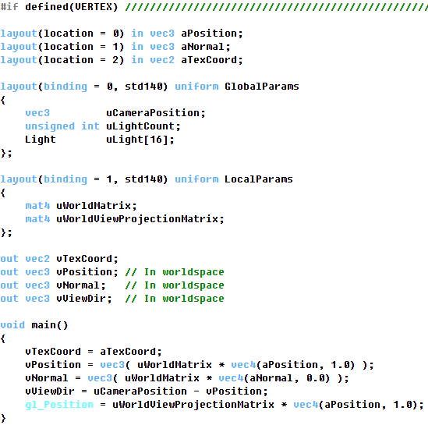
Forward shading vertex shader

Slide 12
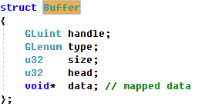
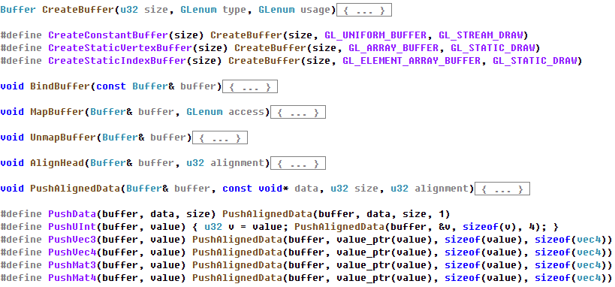
Convenience functions to work with buffers
You have these functions available in the Atenea campus

Slide 13
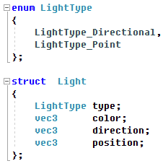
Light struct to store a list of lights in our application
You will have to define these types in Engine.h
Then in your Application struct, create an array/list of lights that you can fill at Init()

Slide 14
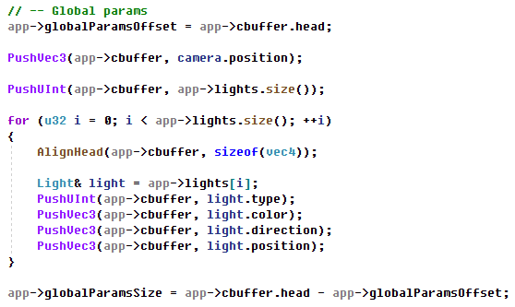
Pushing values for the GlobalParams block into the uniform buffer
Evolved version of uniform buffer setup. Right after mapping the buffer we can start pushing the global parameters.

Slide 15
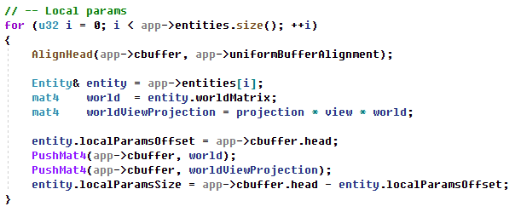
Pushing values for the LocalParams block into the uniform buffer
And here we traverse all entities to push all local parameters.
Do not forget to unmap the buffer once you’ve finished pushing values.

Slide 16
Bind both buffer ranges to the shader blocks
IMPORTANT:
In the previous slides our shader only had one uniform block (LocalParams).
No we have added an extra uniform block into the shader (GlobalParams) and inserted information for it into our uniform buffer.
Do not forget to bind the buffer range with the global parameters (camera position, lights…) to the GlobalParams block in the shader!!!
You only need to bind it once per frame, as all entities share the same GlobalParams.

Slide 17
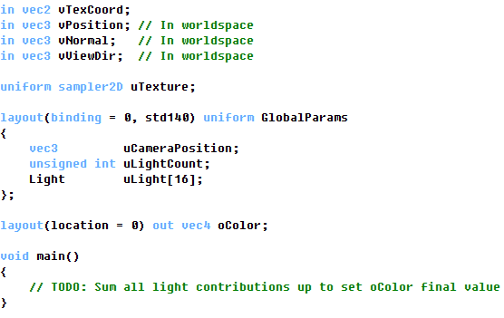
Forward shading fragment shader

Slide 18
Questions?

